Slide 1
RECOMMENDATIONS FOR INFECTION CONTROL, infection PREVENTION and isolation OF COVID-19 IN FACILITIES SERVING ADULTS
Last updated 4/22/2020
DELAWARE DEPARTMENT OF HEALTH & SOCIAL SERVICES

Slide 2
Objectives
Review General Guidelines related to:
Visiting Personnel, Patient Care, Employees, Health Care Workers, and Facility Guidelines
Review Hand Hygiene
Review PPE Usage (Video, Doffing, and Surgical Mask Recommendations/Use)
Review of Isolation Precautions
Review of Testing and Sample Collection
Recommendations related to Patient Transfers and Discharges
Provide SHOC and DHSS Resources

Slide 3
General guidance - updated VISITATION
Notify potential visitors to defer resident visitation until further notice
Restrict visitation of all visitors and non-essential personnel.
Perform active screening on all persons for fever or respiratory symptoms
Any persons with symptoms of a respiratory infection (fever, cough, shortness of breath, or sore throat) are not permitted at any time.
Limit facility access to those performing essential services or functions (such as contractors, delivery personnel etc.).
Require personnel to frequently perform hand hygiene and use PPE such as facemasks based on facility risk assessment and whether or not there is direct contact with patient care areas
Essential personnel are not to be in any area other than those required for the services they are providing in the facility

Slide 4
General guidance updated VISITATION
Disinfect rooms after each resident-visitor meeting
Advise visiting essential personnel or any other individuals entering the facility (hospice staff) to monitor for signs and symptoms of respiratory infection for 14 days after leaving the facility
They need to notify facility if symptoms occur – individual should report date they were at the facility, individuals they were in contact with and locations in the facility they visited.
Facilities should immediately screen all individuals who were in contact with individual

Slide 5
General guidance VISITATION
In lieu of visits:
Offer alternative means of communication for people who would otherwise visit, such as virtual communications (phone, video-communication, etc.).
Create/increase listserv communication to update families.
Assign staff as primary contact to families for inbound calls, and conduct regular outbound calls to keep families up to date.
Offer a phone line with a voice recording updated at set times (e.g., daily) with the facility’s general operating status, such as when it is safe to resume visits.
Communicate through multiple means to inform individuals and non essential healthcare personnel of the visitation restrictions, such as through signage at the entrance/exits, letters, emails, phone calls, and recorded messages for receiving calls.

Slide 6
General guidance All employees
Screen all staff - on each shift, for fever and respiratory symptoms.
Actively take their temperature and document absence of shortness of breath, new or change in cough, and sore throat.
If ill, have them put on a facemask and return home to self-isolate.
Individuals with fevers, other symptoms of COVID-19, or unable to demonstrate proper use of infection control techniques must be restricted from entry.
Identify staff that work at multiple facilities (e.g., agency staff, regional or corporate staff, etc.). Actively screen and restrict them appropriately to ensure they do not place others at the facility at risk for COVID-19.
Employees without direct care or resident contact should wear a non-medical mask.
Dedicate staff and mobile equipment exclusively to a unit/wing to minimize exposures and transmission throughout the facility and in-between facilities
Limit staff working between wing/units as much as possible
REGARDLESS OF EMPLOYEE ROLE
Practice Social Distancing and perform frequent hand hygiene!

Slide 7
General guidance patient care
Actively screen residents and staff for fever and respiratory symptoms. Screen residents each day.
If a resident has symptoms, collect a specimen and call the DPH Office of Epidemiology for instructions on where to take the specimen for testing (this information may be different for COVID outbreak facilities)
No communal dining or group activities
Practice social distancing and perform frequent hand hygiene.
Work to segregate residents to provide staff continuity between those at high risk and those at lower risk.
Cluster care tasks (and medication delivery if possible) to decrease cross contamination risk and frequent entry/exit into resident rooms.
Facilities experiencing an increased number of respiratory illnesses (regardless of suspected etiology) among residents or healthcare personnel should immediately contact the DPH Office of Epidemiology for further guidance.

Slide 8
General guidance health care workers
Follow CDC guidelines for limiting transmission of COVID-19 among healthcare workers found at https://www.cdc.gov/coronavirus/2019-ncov/hcp/guidance-risk-assesment-hcp.html
This applies to health care workers such as hospice workers, EMS personnel, or dialysis technicians that provide care to residents
Health care workers should be allowed into the facility as long as they meet the CDC guidelines for health care workers
Frequently review the CDC website dedicated to COVID-19 for health care professionals https://www.cdc.gov/coronavirus/2019-nCoV/hcp/index.html
Do not restrict EMS personnel in an emergency situation
Surveyors are constantly evaluated by DHCQ to ensure they don’t pose a transmission risk when entering the facility. They should be screened by the facility the same as any individual entering the facility

Slide 9
General guidance health care workers
KEY POINTS
Any staff providing direct care or contact should don appropriate PPE before entering the room.
After care/contact is completed, the gloves should be removed and effective hand hygiene be performed.
It is recommended to keep your mask on during the shift, and change as needed depending upon soiling. DO NOT touch the front of the face mask when doffing.

Slide 10
General guidance facility operations
Review and revise how you interact with vendors and receiving supplies, agency staff, EMS personnel and equipment, transportation providers (e.g., when taking residents to offsite appointments, etc.), and other non-health care providers (e.g., food delivery, etc.), and take necessary actions to prevent any potential transmission. For example, have supply vendors drop off at a dedicated location (e.g., loading dock). Facilities can allow entry of these visitors if needed, as long as they are following the appropriate CDC guidelines for Transmission-Based Precautions.
Increase availability and accessibility of alcohol-based hand rubs (AHRs)
Reinforce strong hand-hygiene practices, tissues, no touch receptacles for disposal, and facemasks at healthcare facility entrances, waiting rooms, resident check-ins, etc.
Ensure AHRs are accessible in all resident-care areas including inside and outside resident rooms

Slide 11
General guidance facility operations
Increase signage for vigilant infection prevention, such as hand hygiene and cough etiquette
Provide additional work supplies to avoid sharing (e.g. pens, pads) and disinfect workplace areas (nurse stations, phones, internal radios, etc.
Review or develop staff contingency plans to mitigate anticipated shortages.

Slide 12
HAND HYGIENE
Handwashing: Resident and Staff APIC Video
"Look At Me“ A hand washing video.
​https://www.youtube.com/watch?v=8WEUoPo8EjE
Must Watch Video

Slide 13
PERSONAL PROTECTIve EQUIPMENT
Employees providing direct resident contact should wear procedural/surgical masks at all times during their shift.
Employees who do not have direct resident contact may not need to wear a medical mask in performing their normal duties, but are recommended to wear a cloth mask at all times during their shift.
Consistent with aerosol precautions, employees should wear an N95 respirator while performing an aerosolizing procedure for presumed/known COVID-19 patient.
A disposable facemask can be worn throughout your shift IF:
NOT visibly soiled
NOT torn or saturated
NOT touched while delivering patient care

Slide 14
PERSONAL PROTECTIve EQUIPMENT
Consistent with contact (gowns and gloves) and droplet (procedure/surgical mask, face shield/goggles) precautions, all other direct contact with residents who are presumed/known COVID-19 infected should not require an N95 respirator.
Hand hygiene should be performed immediately after and before contact.
We recognize this is a departure from standard infection prevention; however, we find ourselves in extraordinary times and given current circumstances, we believe this deviation from standard policy is warranted.
Discard damaged, visibly soiled, torn or saturated masks.

Slide 15
Personal protective equipment
Proper use of PPE/ Donning & Doffing PPE
https://www.youtube.com/watch?v=84CydmuHXD8
Must Watch Video

Slide 16
PERSONAL Protective EQUIPMENT Surgical mask use AND RE-USE
To Doff facemask with intent to reuse:
1. Perform hand hygiene
2. Remove mask Remove procedure mask by holding the ear loops. The front is contaminated, so remove slowly and carefully. Remove surgical mask by untying lower ties FIRST. Untie upper ties last. The front is contaminated, so remove slowly and carefully.
3. After removing facemask, visually inspect for contamination, distortion in shape/form. If soiled, torn, or saturated the mask should be discarded.
4. If the facemask is NOT visibly soiled, torn, or saturated, facemasks should be carefully folded so that the outer surface is held inward and against itself to reduce contact with the outer surface during storage. The folded mask can be stored between uses in a clean sealable paper bag or breathable container.
5. Perform hand hygiene.

Slide 17
PERSONAL Protective EQUIPMENT Surgical mask use AND RE-USE
To Re-Don Mask:
1. Perform hand hygiene.
2. Grasp mask – DO NOT touch the front of the mask.
Pinch procedure mask at the ear loops or
Grasp upper ties on surgical mask.
3. Place over face.
For procedure mask: Secure ear loops behind the ears. Secure mask.
For surgical mask: Secure upper ties first, behind head. End by securing lower ties behind head.
4. Perform hand hygiene.
A disposable facemask can be worn throughout your shift if not visibly soiled, torn or saturated, and NOT touched while delivering patient care.

Slide 18
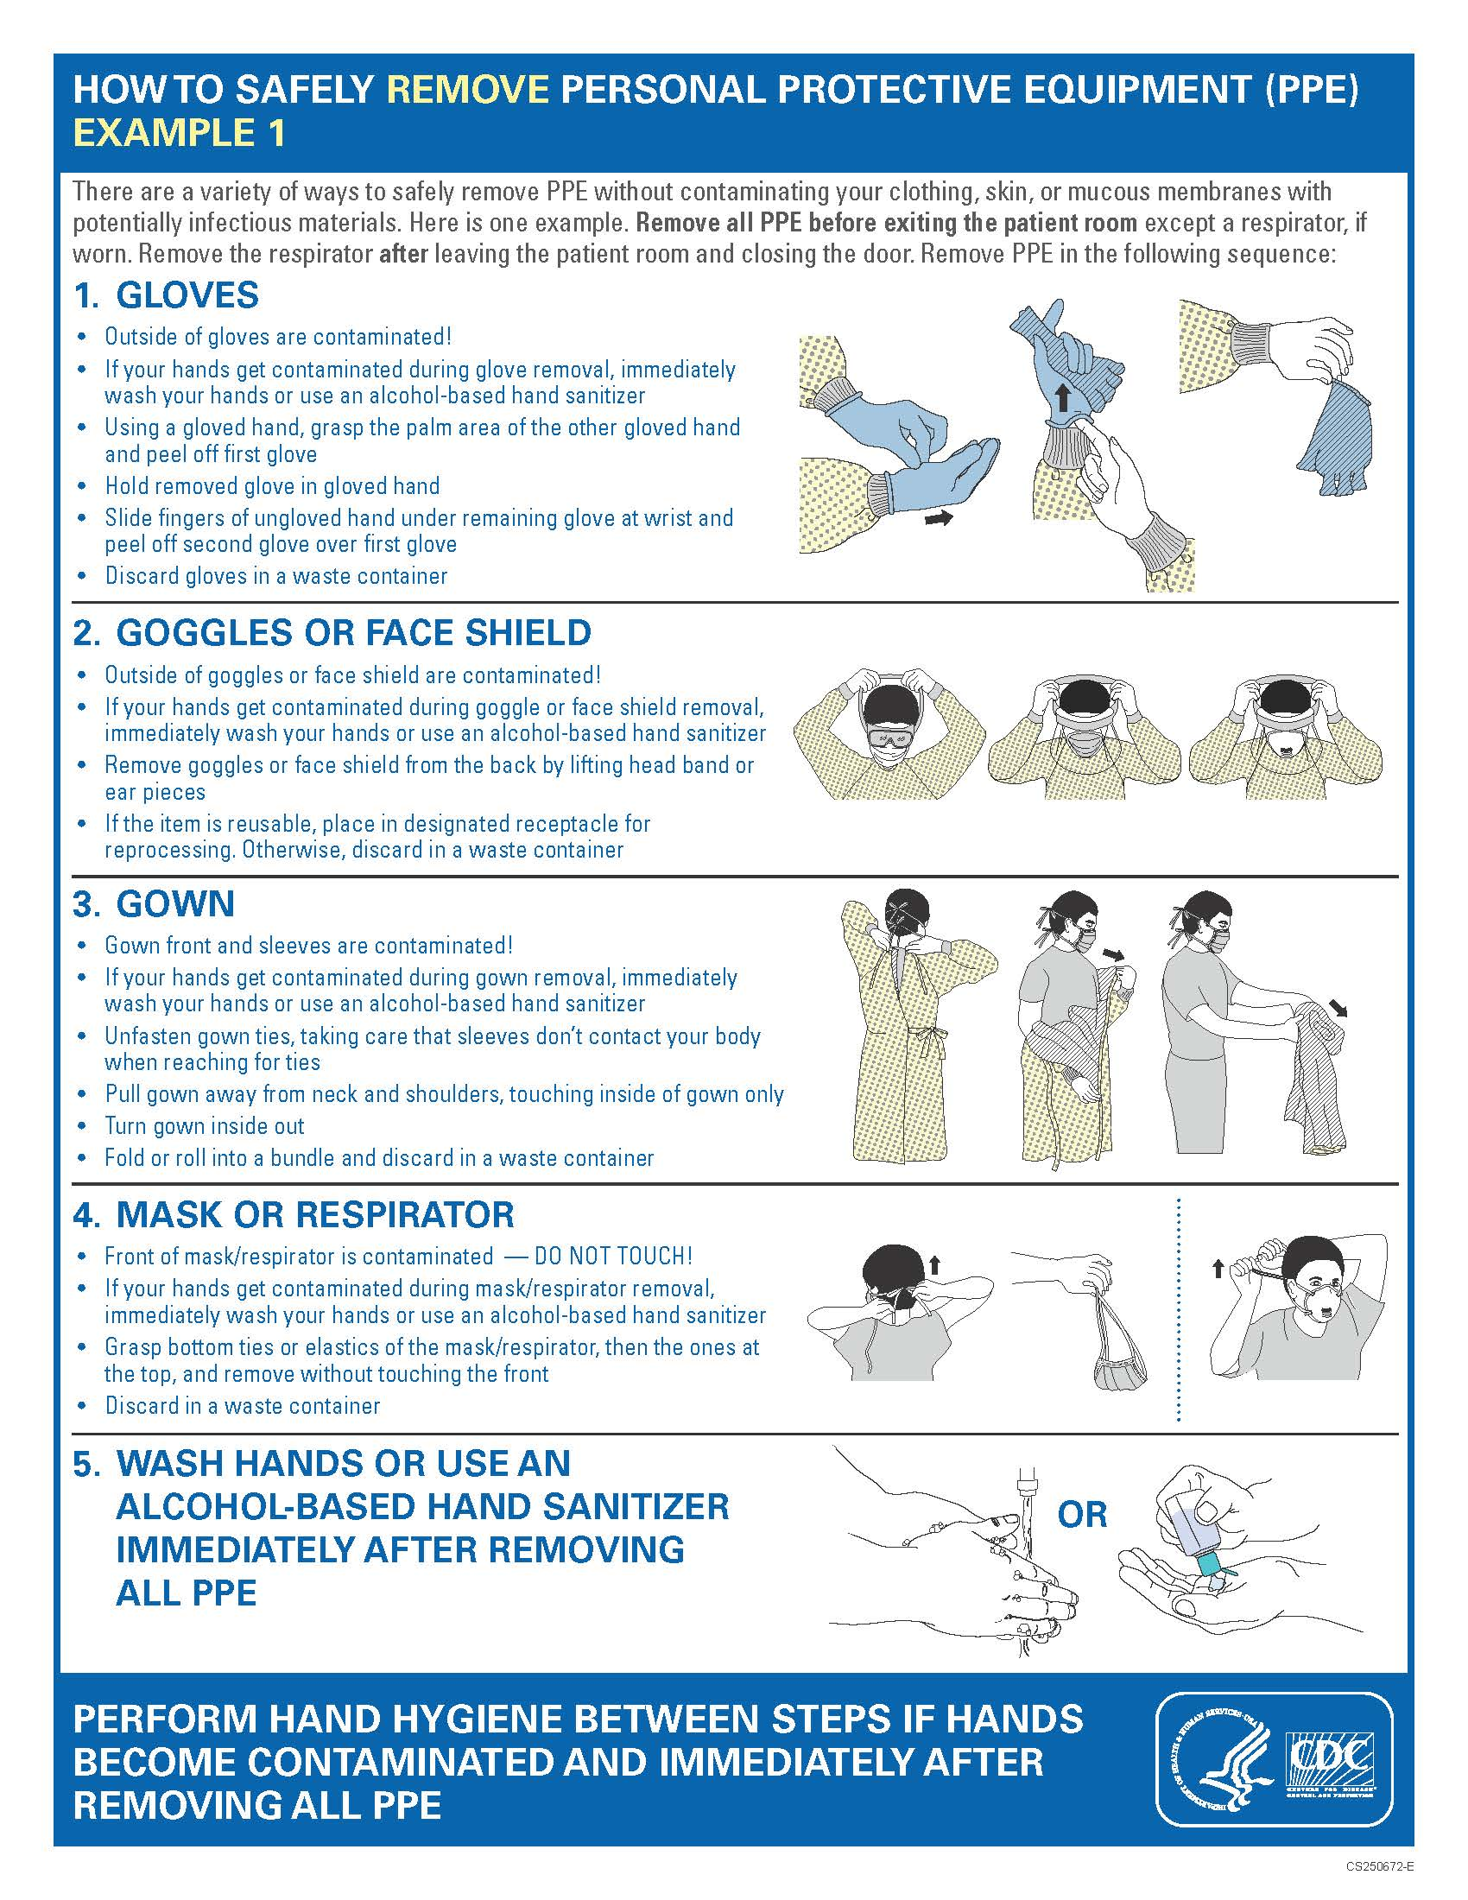
To Review:
Donning
Doffing

Slide 19
PERSONAL Protective EQUIPMENT CDC mask recommendations

Slide 20
Isolation precautions and ppe use (by staff role)
Personnel | Patient type | Procedure | Mask | PPE | Isolation (Y/N)
Direct care staff *Should be wearing a medical/surgical mask at all times during the shift | Asymptomatic or screened negative | Routine patient care tasks or routine patient contact | Medical/surgical mask | Gloves and mask | NO - Not on isolation
 | Symptomatic or pending test results and Confirmed COVID-19 | Routine patient care tasks | Medical/surgical mask | Gloves, gown, medical/surgical mask, eye protection | YES - Place on isolation precautions
 |  | Performance of aerosol inducing procedures | N-95 mask | Gloves, gown, N95 mask, eye protection | YES - Place on isolation precautions
All other staff / employees *Should be wearing a non-medical cloth mask at all times during the shift | With no patient contact *if staff has patient contact - use direct care staff recommendations above | n/a | Non-medical cloth | Cloth mask and gloves as needed depending on task. | n/a

Slide 21
Isolation set up and considerations

Slide 22
Isolation precautions and ppe use
If the patient is placed in isolation:
Patient doors should be closed if possible, but can be left open if needed as long as isolation is maintained.
Precaution signs must be posted on the door.
Isolation carts with supplies and patient care items should be placed in the hall at each patient doorway.
If possible, staff assigned to these patients should not be assigned to patients who are not in isolation.
Patient care/contact should be minimized by: clustering tasks and medication administration, bringing all necessary supplies into the room to limit frequent entering and exiting.
KEY POINTS TO REMEMBER:
Hand hygiene must be performed before and after any patient contact.
Hand hygiene must be performed before and after glove or any other PPE use.
PPE should be donned before entering a patient room and doffed immediately upon exit.

Slide 23
Setting up an isolation area
Isolation areas can vary depending upon facility capabilities.
Requirements:
An area outside the resident’s room where staff can donn and doff PPE
Set up an isolation cart
Apply accurate signage for all persons entering / exiting room

Slide 24
Setting up an isolation area
Located outside room
Can be a taped off area at patient door; or in the alternative - an entire patient care area (wing) where staff are designated to care for only those patients in that area
Top shelf of isolation cart should contain items for rapid response
Linen cart for soiled items
Trash can for used PPE
Signage for all who enter

Slide 25
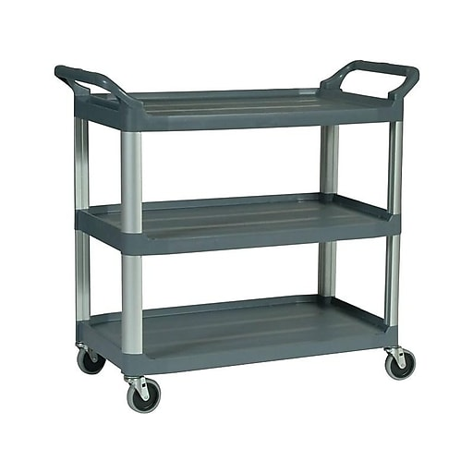
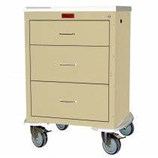
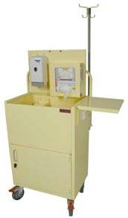
Types of isolation carts (samples of what could be used)

Slide 26
Setting up an isolation cart
The isolation cart (ideally) should be located directly outside the individual’s room, with a trash can and linen cart near doorway.
Each drawer/shelf should have standardized items. For example if using a cart with drawers:
On top: gloves, hand sanitizer, other facility specific items
Top drawer – masks, patient care supplies
Second drawer – gowns, care packets
If using a cart with just shelves:
Top shelf – gloves, hand sanitizer
Bottom shelf – gowns, care packets.

Slide 27
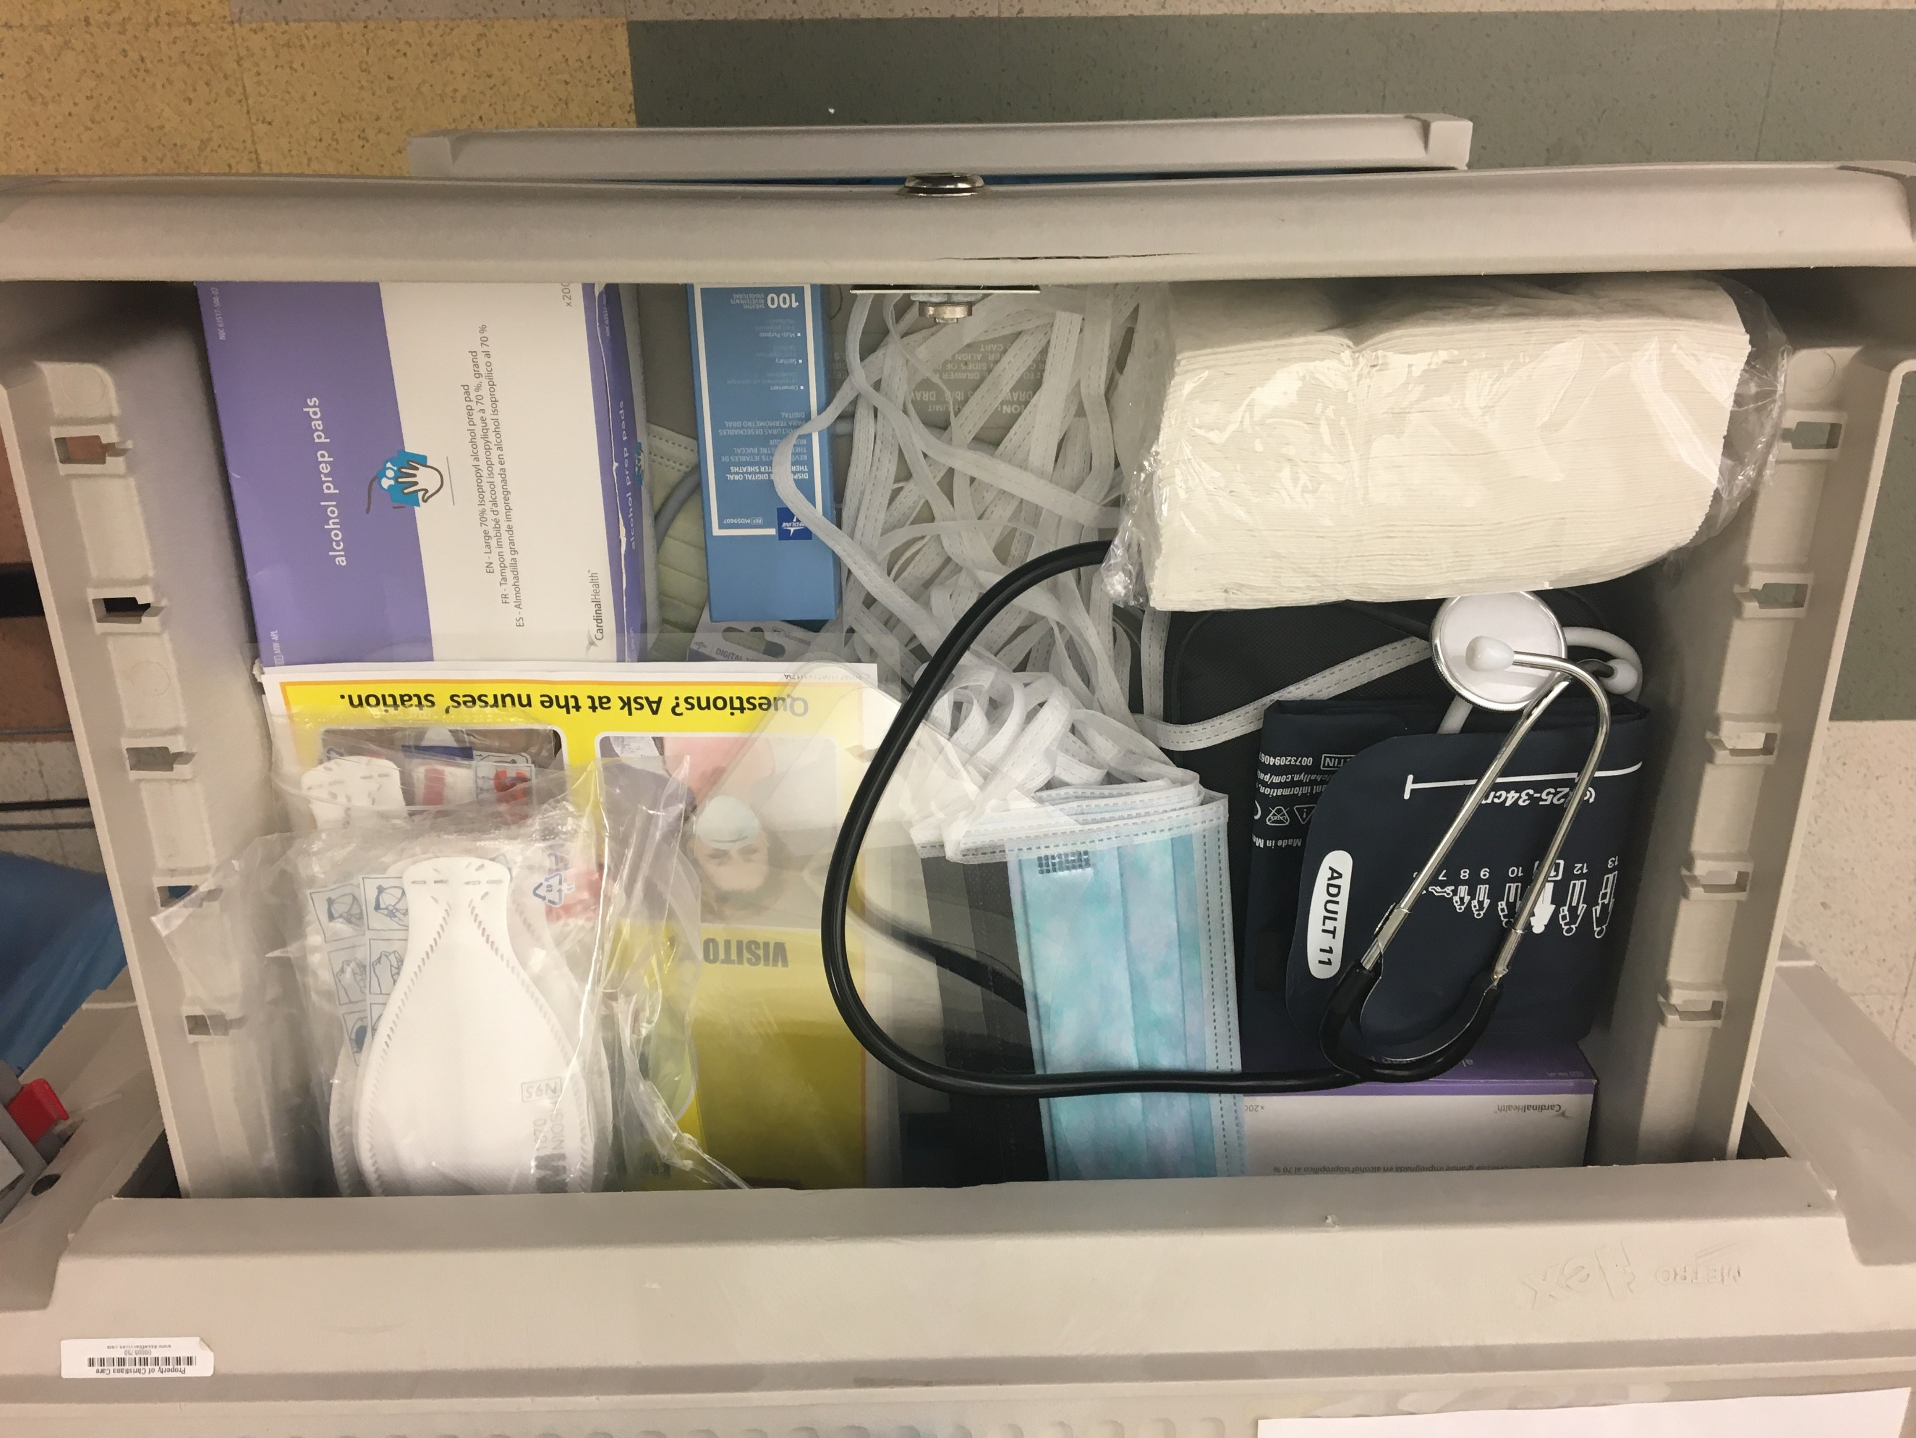
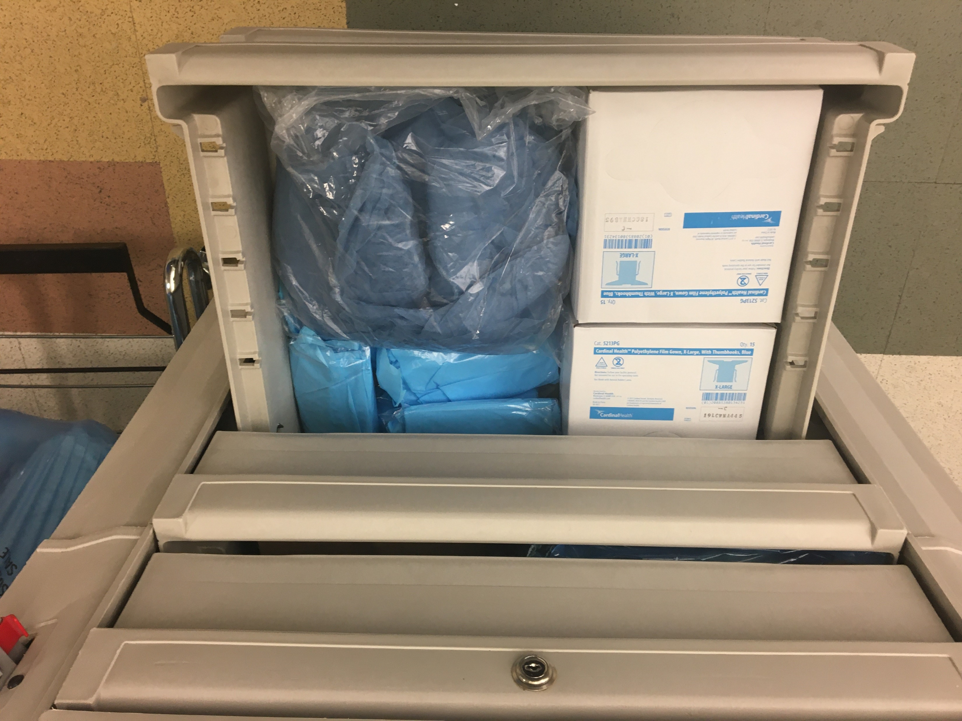
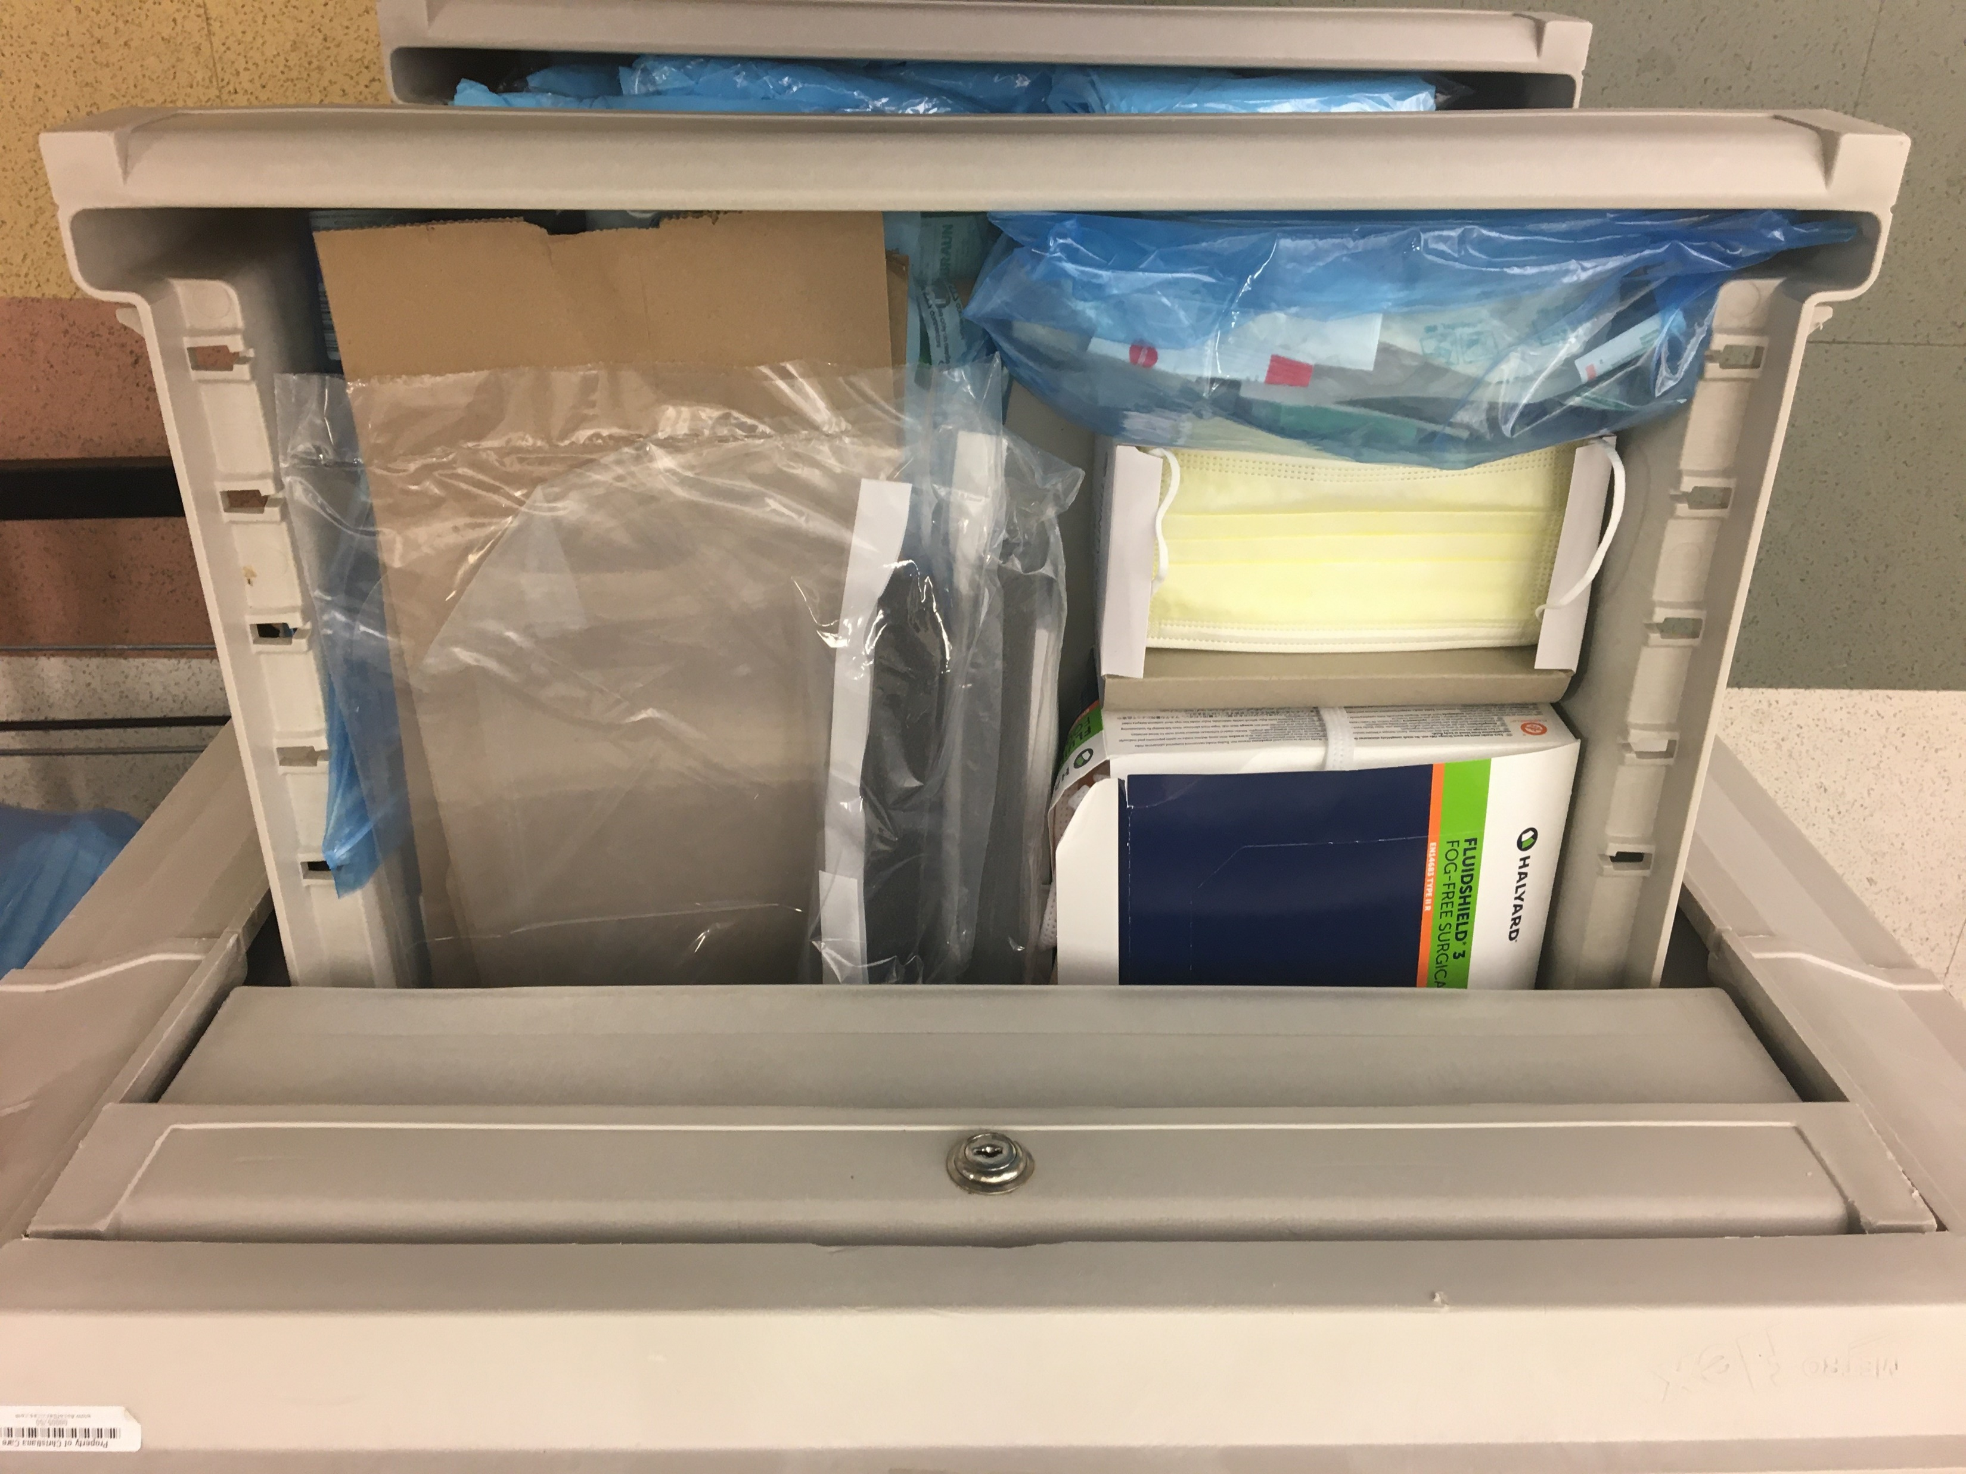
Sample set up of an isolation cart – contents/supplies

Slide 28
Isolation precautions and ppe use demonstration
The following video demonstrates appropriate isolation precautions and PPE donning and doffing.
IMPORTANT NOTE – the activity demonstrated in this video is the same procedure for all activity for any patient in isolation - regardless of whether or not a medical or N95 mask is used.
https://youtu.be/syh5UnC6G2k

Slide 29
SAMPLE COLLECTION
Rapid Point of Care Test: How to Collect a Specimen
https://www.youtube.com/watch?v=s9W5LHy4sW8
Current Testing Option: Nasopharyngeal Swab Obtaining a Specimen
https://youtu.be/DVJNWefmHjE
Must Watch Videos

Slide 30
Rapid Point of care test interpretation
Negative result: to be interpreted in the correct clinical scenario by the ordering provider.
A negative result does not rule out infection with COVID-19
IgM result (regardless of symptoms or presence of IgG): Acute infection with COVID-19
IgG result (in the presence of IgM OR symptoms): Acute infection with COVID-19
IgG result (in the ABSENCE of IgM OR symptoms): presence of an immune response to COVID-19
When specimens are obtained, call the Office of Epidemiology (302) 744-4990 for guidance. Some specimens from a long term care facility may to be tested at the Division of Public Health Lab.

Slide 31
Transfer from Post Acute Care Facility to Hospital
Facilities should not be sending residents to the Emergency Departments solely for COVID-19 testing.
Emergency transfers should be limited to those residents that are in distress or in need of emergent care.
Transfer of Residents with Suspected/Confirmed Infection
Remember, every time you transfer a resident, transfer trauma occurs.
Residents infected with COVID-19 may vary in severity from lack of symptoms to mild or severe symptoms or fatality.
Mild symptoms do not require transfer to a hospital as long as the facility can follow the infection prevention and control practices recommended by CDC.
More severe symptoms may require transfer to a hospital for a higher level of care.
Prior to transfer, emergency medical services and the receiving facility should be alerted to the resident’s diagnosis, and precautions to be taken including placing a non-medical facemask on the resident during transfer.
In addition, the resident’s DNR status must be considered.

Slide 32
Transfer from Post Acute Care Facility to Hospital
NOTE: This guidance is to be used for non-emergency transfer indications only. Emergency transfers should be undertaken per existing facility protocols.
Indications for possible hospital transfer of PUI/COVID 19
Due consideration should be given for alternative diagnoses and interventions undertaken as appropriate.
DNR/DNH/DNI directives should be revisited frequently and resident goals of care addressed.
Decision for transfer should only be made after evaluation by an independently-licensed practitioner.
Nothing in this guidance should be interpreted as to override the clinical judgment of the independently licensed practitioner responsible for the patient.
Indications for transfer will include a clinician's evaluation of vitals and clinical presentation, labs and studies (if performed), resident needs compared to facility capabilities, and the extent to which facilities have implemented and exhausted all appropriate care measures
DPH is working with DHCFA, eBrightHealth ACO, and facility medical directors to develop standardized indications for non-emergency hospital transfer.
This guidance is designed to support facilities in their efforts to limit strain on the hospital infrastructure and provide best care for residents within their facility.

Slide 33
Discharge from Hospital to Post Acute Care Facility
To create a common language surrounding infection control, we are working on creating categories of patients. This is designed to limit confusion surrounding patient/facility needs and capabilities when transferring patients from hospitals to post acute care facilities
Category 1: Non-COVID Patient, no isolation needed
Category 2: Recovered COVID patient, >7 days since symptom resolution, no isolation needed
Category 3: Active or recovering COVID patient, isolation needed
Category 4: PUI requiring isolation awaiting results
Category 5: Exposed and Asymptomatic patients requiring quarantine..
Patients post-hospitalization should be isolated for 14 days. If the facility has the ability to set aside a resident care area or unit for this, they should.
You may accept a resident who was diagnosed with COVID-19 and still under Transmission-Based Precautions for COVID-19 as long as the facility can follow CDC guidance for Transmission-Based Precautions.
FACILITIES SHOULD NOT DENY ACCEPTANCE SOLEY BASED ON COVID-19 STATUS

Slide 34
STATE HEALTH OPERATIONS CENTER (SHOC) Post acute care team
All Questions related to Post Acute Care Facilities should be directed to the SHOC Post Acute Care Team.
The Team can be reached by:
Calling the Division of Public Health Call Center at 1-866-408-1899 and press option 2
Emailing the Post Acute Care Team at DPH_PAC@Delaware.gov

Slide 35
STATE HEALTH OPERATIONS CENTER (SHOC) resources
SHOC Resource Request Form should be used to replenish facility supplies if needed after having asked normal PPE supplier. To request this form please email: OEMS@delaware.gov
For non-PPE items only: complete the resource request form and email it to SHOC_OPS@DELAWARE.GOV
For PPE: please also provide the following information:
Documentation from your normal PPE supplier stating that they are unable to fulfill PPE supply requests.
Signed N95 acceptance letter returned should you be requesting N95 respirators (2nd page of policy)
Has your agency been fit tested for N95 respirators in the past? If so, please specify which model. If not, and you are requesting 3M N95 respirators, please identify the model number: 1860 or 1870?
What is your average weekly patient census?
All requests must be sent to OEMS@delaware.gov

Slide 36
Spread of bacteria
The Invisible Challenge: The Spread of Bacteria in Health Care Settings
https://www.youtube.com/watch?v=9R8fHo6WfzY&feature=youtu.be
Must Watch Video

Slide 37
Additional RESOURCES
Train/educate staff who will be conducting screening into the building
Screen staff prior to facility entry: https://coronavirus.delaware.gov/wp-content/uploads/sites/177/2020/03/Essential-Services-Screening-Policy_3.22.20.pdf
Facility Signage
Recommend posting COVID-19 signage: https://coronavirus.delaware.gov/wp-content/uploads/sites/177/2020/03/COVID-Business-Sign-1.pdf
Personal Protective Equipment
https://www.cdc.gov/coronavirus/2019-ncov/hcp/ppe-strategy/face-masks.html;
https://www.cdc.gov/coronavirus/2019-ncov/hcp/ppe-strategy/index.html
Check the following link regularly for critical updates, such as updates to guidance for using PPE: https://www.cdc.gov/coronavirus/2019-ncov/infection-control/controlrecommendations.html.

